Slide 1

Team
Byte Builders
Presented By : Rakshith B Jyothi Ruchitha K M Sushmitha Abhishek V M
Divyashree

Slide 2
Introduction to Matplotlib & Line Plots
Matplotlib
A popular Python library for data visualization
Used to create static graphs and charts
Widely used in data science and reporting
Line Plot
Shows data points connected by straight lines
Used to display trends over time or continuous data
Helps easily understand growth, decline, or patterns
Common Uses of Line Plot
Stock market analysis
Performance tracking
Time-series data visualization

Slide 3
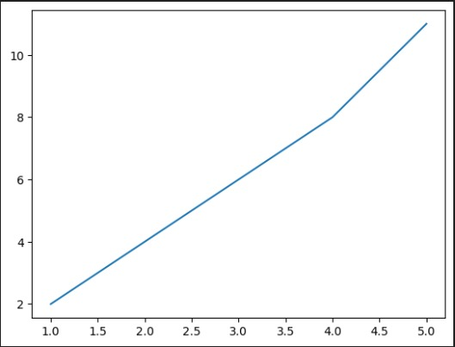
Examples
import matplotlib.pyplot as plt
# Sample data
days = [1, 2, 3, 4, 5]
temperature = [30, 32, 31, 35, 36]
# Create line plot
plt.plot(days, temperature)
plt.xlabel("Days")
plt.ylabel("Temperature (°C)")
plt.title("Daily Temperature Trend")
# Show plot
plt.show()

Slide 4
Scatter Plots for Relationship Analysis
Scatter Plot
Displays individual data points
Points are not connected by lines
Why Use It?
Shows relationship between two numerical variables
Helps identify patterns, correlations, or clusters
Common Uses
Machine learning feature analysis
Correlation studies
Data relationship visualization

Slide 5
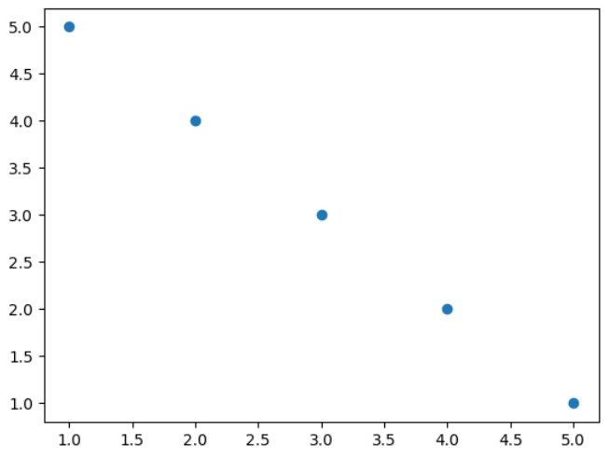
Example
import matplotlib.pyplot as plt
x = [1, 2, 3, 4, 5]
y = [5, 4, 3, 2, 1]
plt.scatter(x, y)
plt.show()

Slide 6
Bar Charts for Categorical Data
Bar Chart
Uses rectangular bars to represent data
Height of each bar shows the value
Why Use It?
Compares quantities across categories
Easy to understand differences
Common Uses
Sales per product
Students per department
Survey results comparison

Slide 7
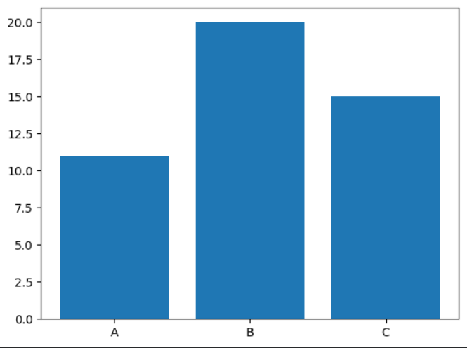
Example
import matplotlib.pyplot as plt
categories = ['A', 'B', 'C']
values = [11, 20, 15]
plt.bar(categories, values)
plt.show()

Slide 8
Customizing Plots & Subplots
Customization
Add titles and axis labels
Include legends and grids
Improves clarity and readability
Subplots
Display multiple plots in one figure
Helps compare data easily
Why Important?
Makes graphs informative
Creates presentation-ready visualizations

Slide 9
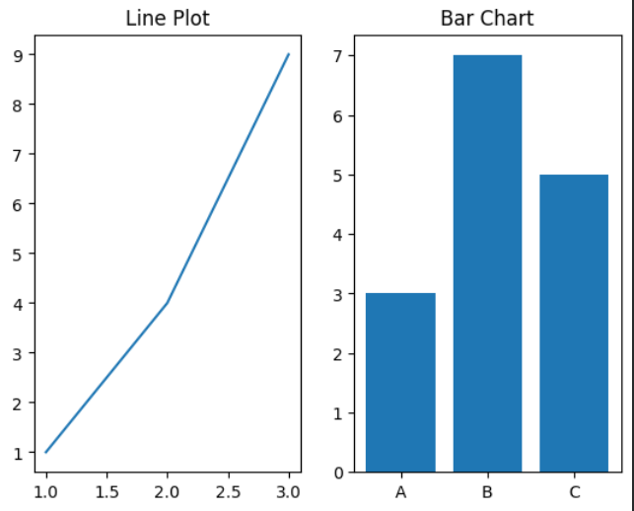
Example
import matplotlib.pyplot as plt
plt.subplot(1, 2, 1)
plt.plot([1,2,3], [1,4,9])
plt.title("Line Plot")
plt.subplot(1, 2, 2)
plt.bar(['A','B','C'], [3,7,5])
plt.title("Bar Chart")
plt.show()

Slide 10


